Slide 1
Solving Geometry Problems
Pankaj Prateek, Jeetesh Mangwani

Slide 2
Overall Objective
To develop a system that tutors the user on geometry construction problems

Slide 3
Current Objectives
To develop a system that
Draws simple geometric figures, given the construction steps
Is independent of the input language used

Slide 4
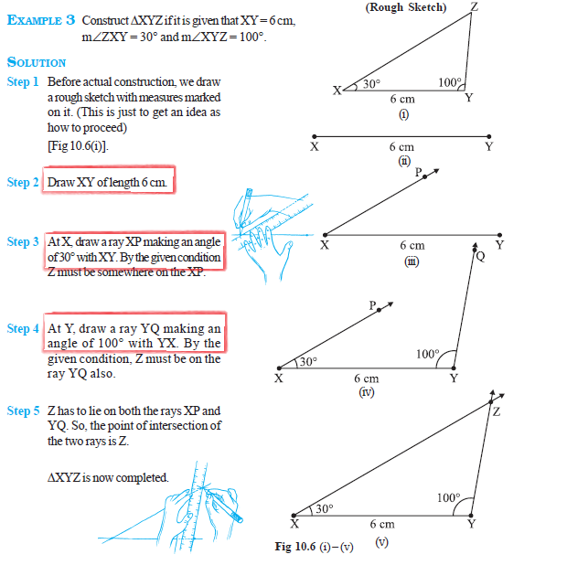
sample problems

Slide 5
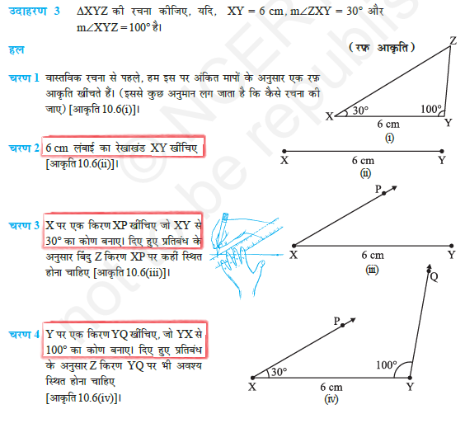
sample problems

Slide 6
RELATED works
Authors | Work
Gulwani et. al. [2] | Uses goal-based heuristic to simulate backward deduction; solves problem expressed in terms of predefined logical constructs
Schreck et. al.[5] | Uses CAD methods to deal with constrants
Itshaky et al.[3] | Uses number of nondeterministic choices as a measure of good solution
Ahmed, Umair et. Al.[1] | Uses domain specific measures to minimize parser errors and augment the geometry problem solver, GeoSynth

Slide 7
observations
Authors | Uses domain knowledge | Assumes linguistic clues already translated into logical constructs | Uses parse knowledge
Gulwani et. al. [2] | YES | YES | NA
Schreck et. al.[5] | YES | YES | NA
Itshaky et al.[3] | YES | YES | NA
Ahmed, Umair et. Al.[1] | YES | NO | YES

Slide 8
Proposed approach
Cross-lingual Alignment
+
Heuristic based parsing

Slide 9
Characteristic features
Scalable to any number of input languages
Uses an intermediate metalanguage to express intended construction steps
Assumes availability of corpus corresponding to each input language

Slide 10
What is cross-lingual alignment?
Assigns probability to the event that a particular source language token corresponds to a particular target language token

Slide 11
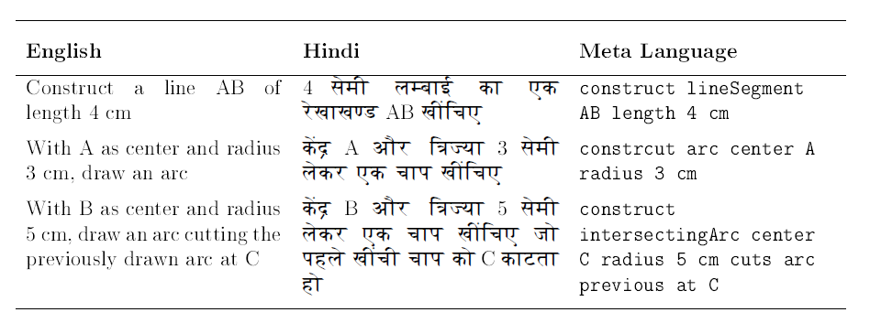
Parallel corpus

Slide 12
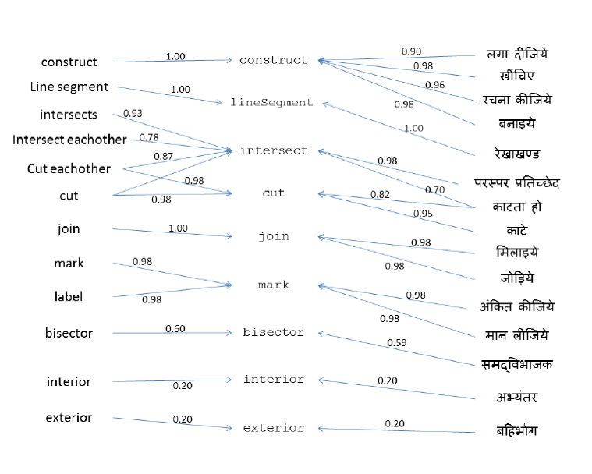
Sample alignment

Slide 13
alignments
Language A
Map
A to B
Language B
Map
B to A

Slide 14
Aligning languages
L0: Fixed predicate language (carefully designed)
NL[i]: ith natural language, 1<= i <= n
A[i]: word alignment between NL[i] and L0
Cross-lingual alignment
Alignment for
NL[i]
NL[i] sentences expressed in L0
NL[i] sentences

Slide 15
overview
C[i]
C[j]
C[k]
Aligner
Alignments
Input
Interpreter
Interpretation
Drawer
Graphic
Construction step

Slide 16
interpreter
English
Input
With A as center and same radius, draw an arc which cuts AB at G
A center same radius construct arc intersecting AB at G
Translation to
Metalanguage
Order differs with language!
A center same radius AB G at intersecting arc construct
Hindi
Input
A को केंद्र मानकर और वही चाप लेकर, AB को G पर काटता हुआ एक चाप लगाइये
Stack-based parsing cannot be applied here

Slide 17
Important Assumption
Parameter names and their values are close to eachother in the metalanguage translation.

Slide 18
interpreter
English
Input
With A as center and same radius, draw an arc which cuts AB at G
A center previous radius construct arc intersecting AB at G
Translation to
Metalanguage
A center previous radius AB G at intersecting arc construct
Hindi
Input
A को केंद्र मानकर और वही चाप लेकर, AB को G पर काटता हुआ एक चाप लगाइये

Slide 19
Desired tree structure
A center previous radius AB G at intersecting arc construct
construct
arc
Intersecting
center
A
radius
previous
AB
at
G

Slide 20
Metalanguage grammar
CUT
line segment
length
POINT DOUBLET
from
ray
POINT DOUBLET
REAL
command
cuttable and properties
CM
LINE SEGMENT
FROM
RAY
A center previous radius AB G at intersecting arc construct
construct

Slide 21
Metalanguage grammar
CONSTRUCT
arc
command
constructible and properties
ARC
arc and properties
radius
RADIUS
length
INTERSECTING
line segment
at
AT
POINT SINGLET
previous line segment
PREVIOUS
LINE SEGMENT
POINT DOUBLET
intersecting
center
POINT SINGLET
CENTER
A center previous radius AB G at intersecting arc construct
construct
intersecting
arc
center
radius
A
AB
previous
??

Slide 22
Metalanguage grammar
CONSTRUCT
arc
command
constructible and properties
ARC
arc and properties
radius
RADIUS
PREVIOUS
INTERSECTING
line segment
at
AT
POINT SINGLET
intersecting
center
POINT SINGLET
CENTER
POINT DOUBLET
A center previous radius AB G at intersecting arc construct
construct
intersecting
arc
center
radius
AB
at
A
previous
G

Slide 23
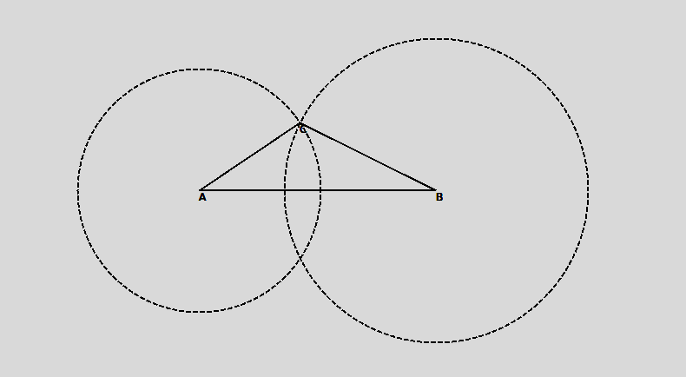
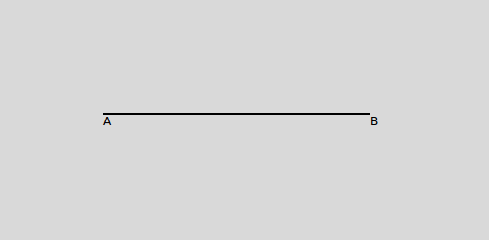
Sample run
Construct line segment AB of length 7.8 cm
With A and B as centers and radius 4 and 5 cm draw two arcs intersecting each other at C
Join AC
Join BC
7.8 सेमी लम्बाई का एक रेखाखण्ड AB खींचिए

Slide 24
IMMEdiate work
Implement the Heuristic based parsing
Report accuracy and time complexity

Slide 25
references
[1] Umair Z Ahmed, Arpit Kumar, Monojit Choudhury, and Kalika Bali. Can modern statistical parsers lead to better natural language understanding for education? In Computational Linguistics and Intelligent Text Processing, pages 415427. Springer, 2012
[2] Sumit Gulwani, Vijay Anand Korthikanti, and Ashish Tiwari. Synthesizing geometry constructions. In ACM SIGPLAN Notices, volume 46, pages 5061. ACM, 2011.
[3] Shachar Itzhaky, Sumit Gulwani, Neil Immerman, and Mooly Sagiv. Solving geometry problems using a combination of symbolic and numerical reasoning. Technical report, Technical report, Tel Aviv University, 2012.
[4] Franz Josef Och and Hermann Ney. A systematic comparison of various statistical alignment models. Computational linguistics, 29(1):1951, 2003.
[5] Pascal Schreck, Pascal Mathis, and Julien Narboux. Geometric construction problem solving in computer-aided learning. In Tools with Articial Intelligence (ICTAI), 2012 IEEE 24th International Conference on, volume 1, pages 11391144. IEEE, 2012.
[6] Luke S Zettlemoyer and Michael Collins. Learning to map sentences to logical form: Structured classication with probabilistic categorial grammars. arXiv preprint arXiv:1207.1420, 2012.

Slide 26
Thank you!

Slide 27
GIZA++
GIZA++ is a statistical machine translation toolkit
Used to train IBM Models 1-5 and an HMM word alignment model.
http://code.google.com/p/giza-pp/
Franz Josef Och, Hermann Ney. "A Systematic Comparison of Various Statistical Alignment Models", Computational Linguistics, volume 29, number 1, pp. 19-51 March 2003.

Slide 28
difficulties
Anaphoras
“एक सुविधाजनक त्रिज्या लेकर पिछले चरण वाले चाप को बिंदु A पर काटें”
Underspecified Parameters
“With A and B as centers and a suitable radius, draw two arcs intersecting each other at point C”
Probabilistic Mapping
Mapped metalanguage sentence | Probability
Construct AB any length 7.8 cm | 0.71683
Construct AB lineSegment length 7.8 cm | 0.21081
Construct AB angle length 7.8 cm | 0.07232
Construct AB center length 7.8 cm | 1.90645e-06

